Slide 1
Muscles Continued
P. 184-189

Slide 2
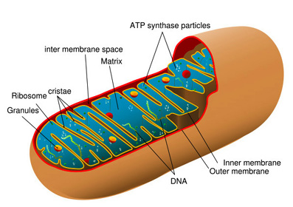
Energy Sources for Contraction
ATP is the supplied energy for muscles
Can only supply enough for a short period of time
ATP is generated from Creatine Phosphate
Contains high energy phosphate bonds
4-6x more abundant in muscles than ATP
Cannot directly supply energy
Stores excess energy from mitochondria
Once creatine phosphate is depleted, muscles depend on cellular respiration as energy source

Slide 3
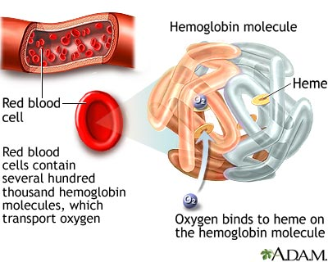
Oxygen Supply and Cellular Respiration
Aerobic respiration requires oxygen
Blood cells carry oxygen to body cells by attaching to hemoglobin
Myoglobin
Causes reddish brown color of skeletal muscles
Can combine loosely with oxygen
Reduces muscles requirement for a
continuous blood supply during contraction

Slide 4
Oxygen Debt
Oxygen Debt
Is the amount of oxygen required to convert accumulated lactic acid to glucose and to restore the supplies of ATP and creatine phosphate
Muscles receive enough oxygen aerobically during rest or moderate exercise
Strenuous exercise causes an oxygen deficiency and may lead to lactic acid build up. (anaerobic respiration)

Slide 5
Oxygen Debt Cont.
Glucose is broken down to pyruvic acid during anaerobic respiration
If oxygen is low, pyruvic acid converts to lactic acid
Lactic acid diffuses out into blood stream and is transported to liver
Oxygen debt is equal to the amount of oxygen liver cells need to convert lactic acid back to glucose plus the amount of muscles cells require to restore ATP and creatine phosphate to original concentrations
Time to restore is slow following vigorous exercise

Slide 6
Muscle Fatigue
A muscle loosing it’s ability to contract
Typically caused by accumulation of lactic acid
Build up lowers pH causing fibers to no longer respond to stimulation
Cramps
A painful condition in which the muscle contracts spasmodically but does not relax completely inbetween contractions.
Due to a lack of ATP

Slide 7
Medical Minute
Several hours after death, the skeletal muscles undergo partial contraction that fixes the joints. This condition, rigor mortis, may continue for 72 hours or more. It results from an increase in membrane permeability to calcium ions and a decrease in ATP in muscle fibers, which prevents relaxation. Thus, the actin and myosin filaments of the muscle fibers remain linked until the muscles begin to decompose.

Slide 8
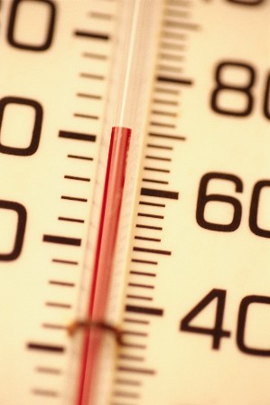
Heat Production
25% of energy released in cellular respiration is available for use.
The rest is lost as heat
Muscles are major heat sources because muscles are such a large proportion of total body mass.

Slide 9
Muscular Responses
Threshold Stimulus
Minimal stimulus required to elicit a muscular contraction
All or None response
Once threshold is reached, muscle responds to it’s fullest extent.
Cannot partially contract

Slide 10
Recording a Muscle Contraction
Myogram
Records the movement of a stimulated muscle
Twitch
A single contraction that lasts only for a fraction of a second
Latent Period
The delay between the time the stimulus was applied and the time the muscle responds
In frogs it’s .01 seconds, in humans it’s shorter
Period of contraction: occurs when muscle pulls at it’s attachments
Period of Relaxation: occurs when it returns to former length

Slide 11
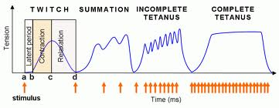
Myogram

Slide 12
Summation
Process by which the force of individual twitches combines is summation
Point at which a muscle can’t completely relax before the next contraction
Tetanic contraction (tetanus)
When the resulting forceful, sustained contraction lacks even partial relaxation

Slide 13
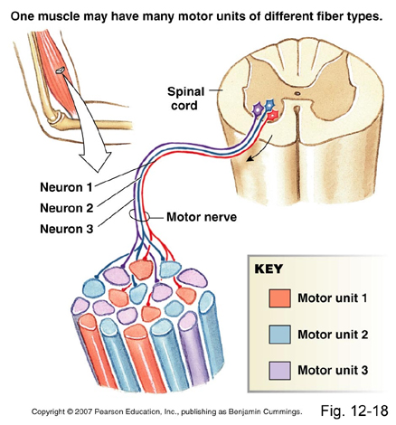
Recruitment of Motor Units
Recruitment
At a low intensity of stimulation, small numbers of motor units contract.
At an increasing intensity of stimulation, other motor units are recruited until the muscle contracts with maximal tension.

Slide 14
Sustained Contractions
Summation and Recruitment produce a sustained contraction of increasing strength
A titanic contraction is forceful and sustained
When a muscle appears to be at rest, a certain amount of sustained contractions are occuring
Muscle Tone
Is a response to nerve impulses originating repeatedly from the spinal cord and traveling to small numbers of muscle fibers
Partially important in maintaining posture
If tone is lost, unconsciousness, person collapes

Slide 15
Use and Disuse of Skeletal Muscles
Muscular Hypertrophy
Enlargement of muscles through forceful exercise
Muscular Atrophy
Decreasing size and strength of muscles
Slow Twitch Fibers
Fatigue-resistant, typically weak contraction (swimming and running)
Develop more mitochondria
Size and strengths remain unchanged
Fast Twitch Fibers
Fatigable, muscles forcefully exert more than 75% of maximum tension
Produce new actin and myosin filaments
Diameter of fiber increases and entire muscle enlarges

Slide 16
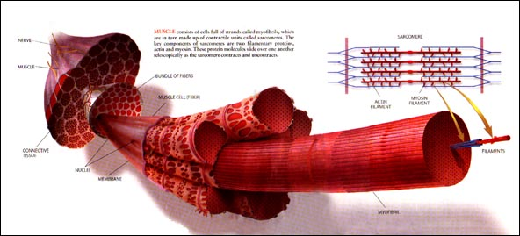
Use and Disuse Cont.
Strength of muscular contraction is directly proportional to diameter of activated muscle.
An unused muscle may decrease to less than half its usual size within a few months

Slide 17
Medical Minute
When skeletal muscles contract very forcefully, they may generate up to 50 pounds of pull for each square inch of muscle cross section. Consequently, large muscles such as those in the thigh can pull with several hundred pounds of force. Occasionally, this force is so great that the tendons of muscles tear away from their attachments to the bones (muscle pull)

Slide 18
Smooth Muscles
Two major types of smooth muscle
Multiunit smooth muscle
The muscle fibers occur as separate fibers rather than in organized sheets
Found in irises of eyes and walls of blood vessels
Typically contracts only after stimulation by motor nerve impulses or certain hormones
Visceral Smooth Muscles
Composed of sheets of spindle-shaped cells in close contact with one another
More common and found in walls of hollow organs (stomach, intestines, bladder and uterus)

Slide 19
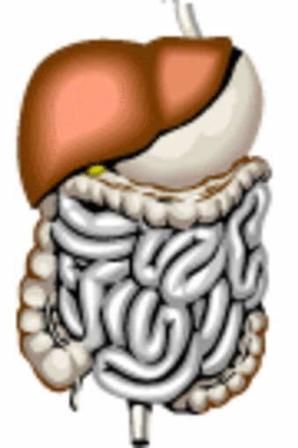
Smooth Muscles Cont.
Visceral smooth muscle display rhythmicity and is self exciting
Peristalsis
Occurs in certain tubular organs (intestines, esophagus) and helps force the contents in these organs along their lengths

Slide 20
Smooth Muscle Contraction
Very similar to skeletal contraction with a few differences
Two Neurotransmitters:
Acetylcholine and norepinephrine
Stimulates in some smooth muscles and inhibits in others
Hormones
Stimulate contractions in some cases and alter the degree of response to neurotransmitters in others
Slow to contract and relax
Can maintain forceful contraction longer and stretch as organs fill without changing pressure of muscles

Slide 21
Cardiac Muscle
Twitches take longer than skeletal muscles
Intercalated discs connect the ends of adjacent cardiac muscle cells
A network of fibers contracts as a unit and responds to stimulation in an all-or-none manner
Cardiac muscle is self-exciting and rthythmic
See type of muscle tissue comparisons in Table 8.2 on page 190.

